Slide 1

Asian American College Access

Slide 2
Overview
Research Question
Literature Review
Framework
Methodology and data
Analysis
Findings and conclusions
Implications

Slide 3
Research Question
Understand the different experiences of Asian American ethnic groups across Philadelphia and their access to higher education utilizing K-clustering and Moran’s I

Slide 4

Literature Review

Slide 5
Literature Review
Asian American Geography
Liu's (2018) ethnography highlighted highlights the differences in Asian American perspectives, they built a framework that includes three parts.
discourse on Xi Jinping's "Chinese Dream," which emphasizes class advancement
ethnic empowerment through market liberalization
expansion of, specifically, Chinese capital.
The Chinese Dream can be applied to the Chinese immigrants' movement that moved into ethnoburbs following Japanese and Mexican Americans, which fundamentally reshaped the ethnoburb
In Chan’s (2017), study on geographic differences in being Asian American the theme of race as a social identity was broken updivided into four subthemes:
distancing racial identity,
the strategic use of racial identity,
shifting experiences of race and racial identity to describe the importance of students' hometowns and high schools
how they now felt about their racial context.

Slide 6
Asian American Categorization

Slide 7
College Access Frameworks
Perna (2006) offers a conceptual model of higher education which encompasses four layers:
habitus,
school and community context,
higher education context,
social, economic and policy context.
Turley argues that college choice must be situated in the geographic context and found that high school seniors had a wide range of colleges within commuting distance, zip code had a small but significant increase in the odds of applying to college.

Slide 8
Framework: Critical Geographic College Access (Dache, 2021)
Spatial relationship between municipality and colleges using
History
Racial segregation
Education and economic data
Focuses on physical access
Public Transit
Distance
Proximity of colleges to residents of color

Slide 9

Methodology

Slide 10
Data
ACS Data
Safegraph Point Data
IPEDS University Data
Home Owner Loan Corporation data

Slide 11
List of Methods
Moran’s I
Local Indicator of Spatial Association (LISA)
Moran’s I has been widely used to test for spatial autocorrelation or spatial dependencies and its value determines the strength of autocorrelation indicating how clustered values are.
Values that are closer to 1 indicate strong positive autocorrelation, while values closer to -1 indicate negative autocorrelation that being how repelled values are. Conversely, if values are positively autocorrelated they are spatially clustered. If the value is close to 0, then there is no spatial autocorrelation, indicating a random pattern.
the LISA for each observation gives an indication of the extent of significant spatial clustering of similar values around that observation and
the sum of LISAs for all observations is proportional to a global indicator of spatial association.The LISA we will be looking at is Moran’s I at a local level for each point. In our case each census block calculated individually and then summed to provide the I in the Moran's I.

Slide 12

Analysis

Slide 13
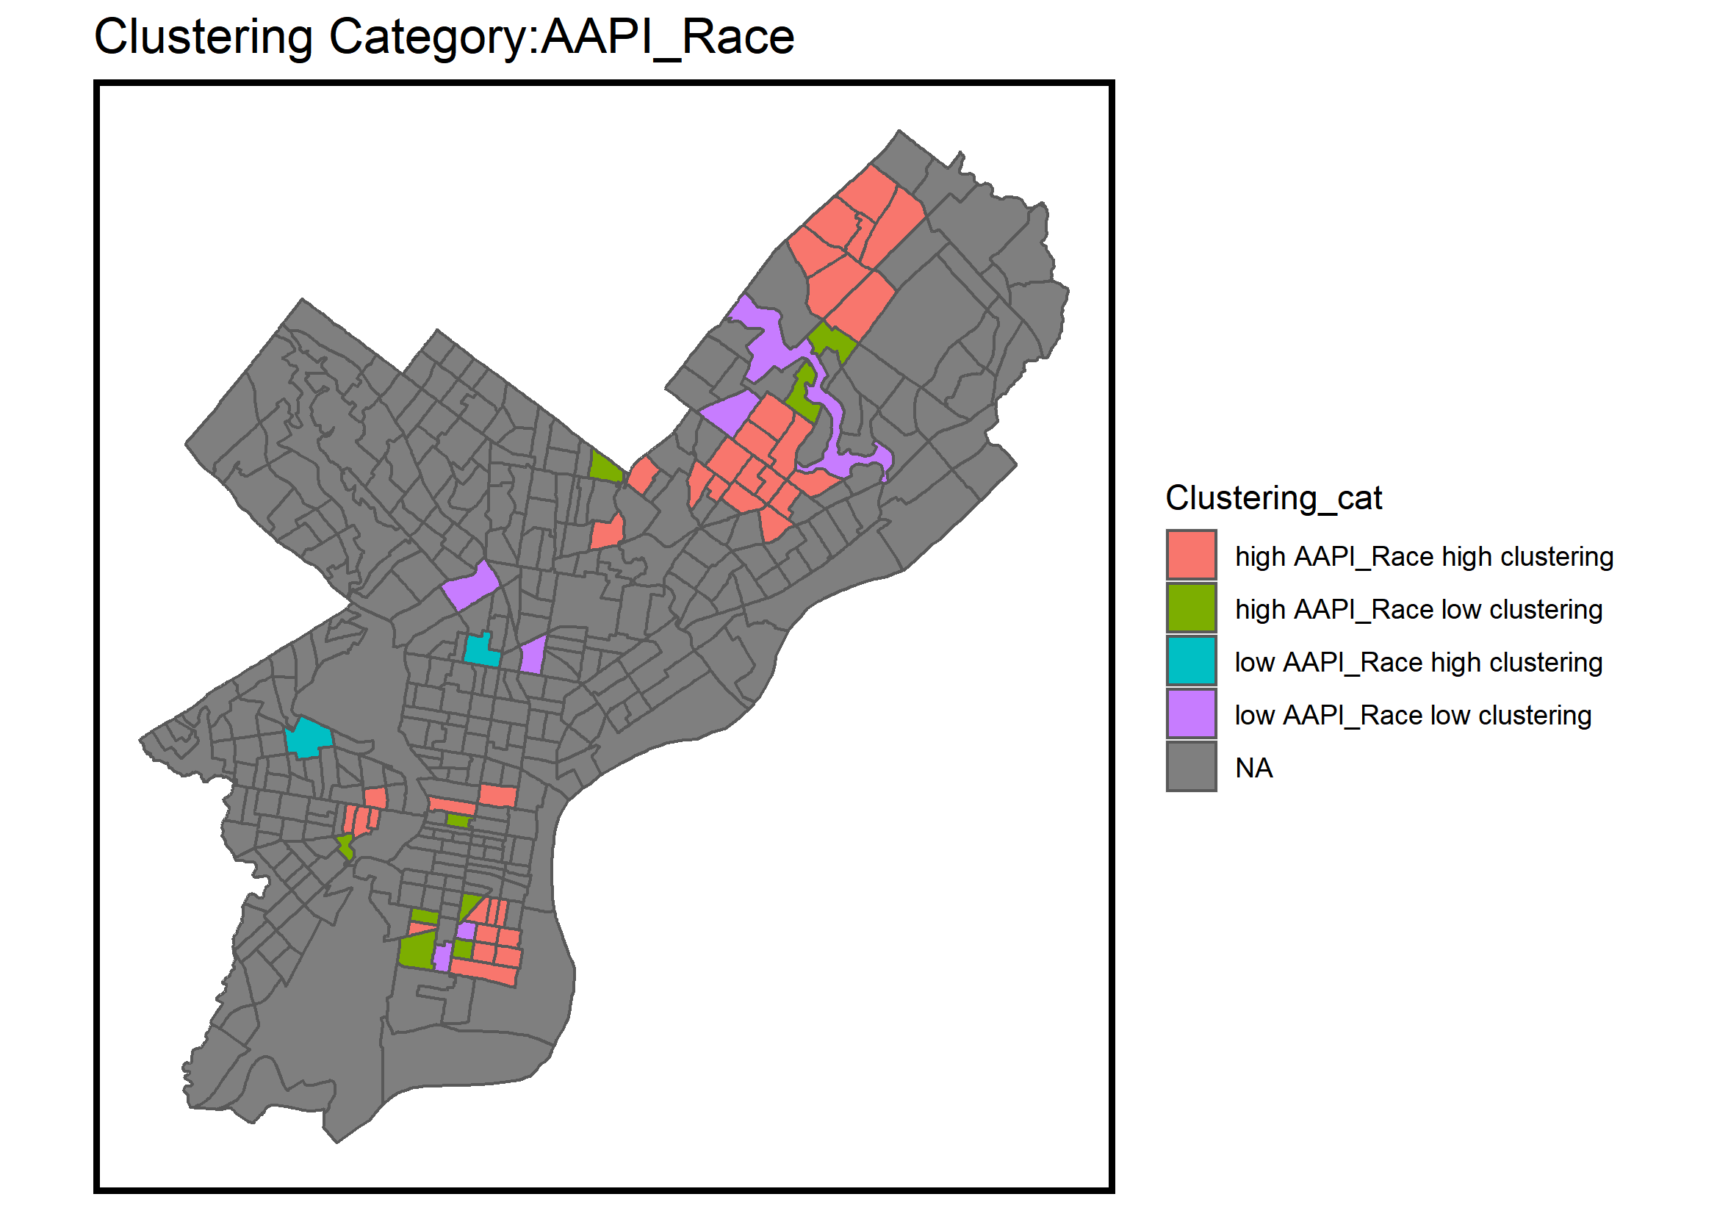
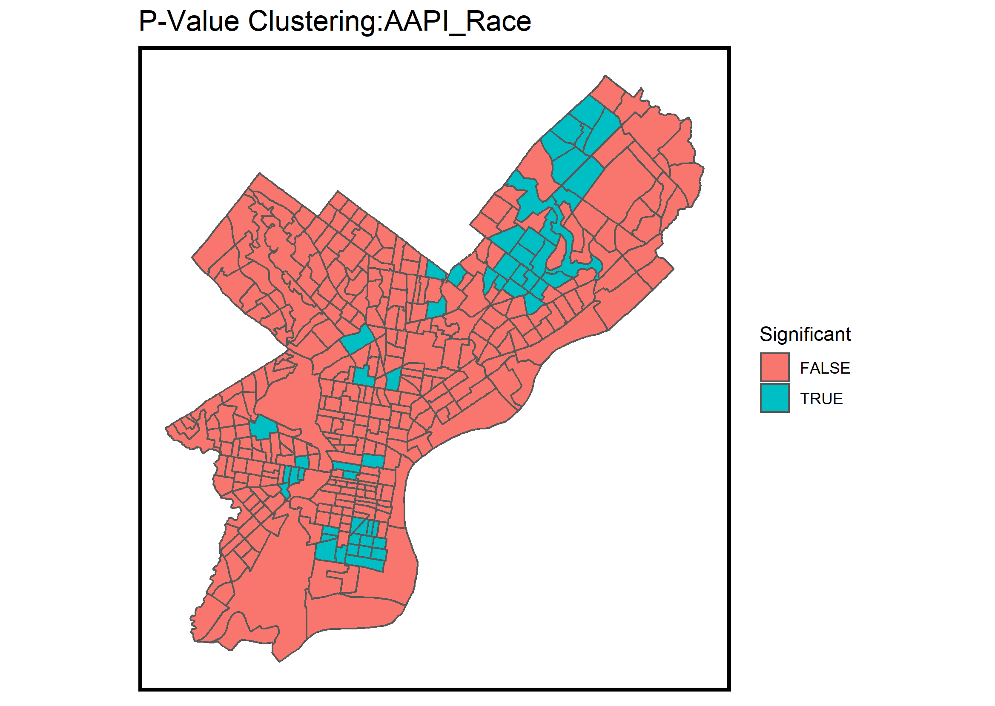
Moran’s I
Are Asian Americans Clustered?

Slide 14
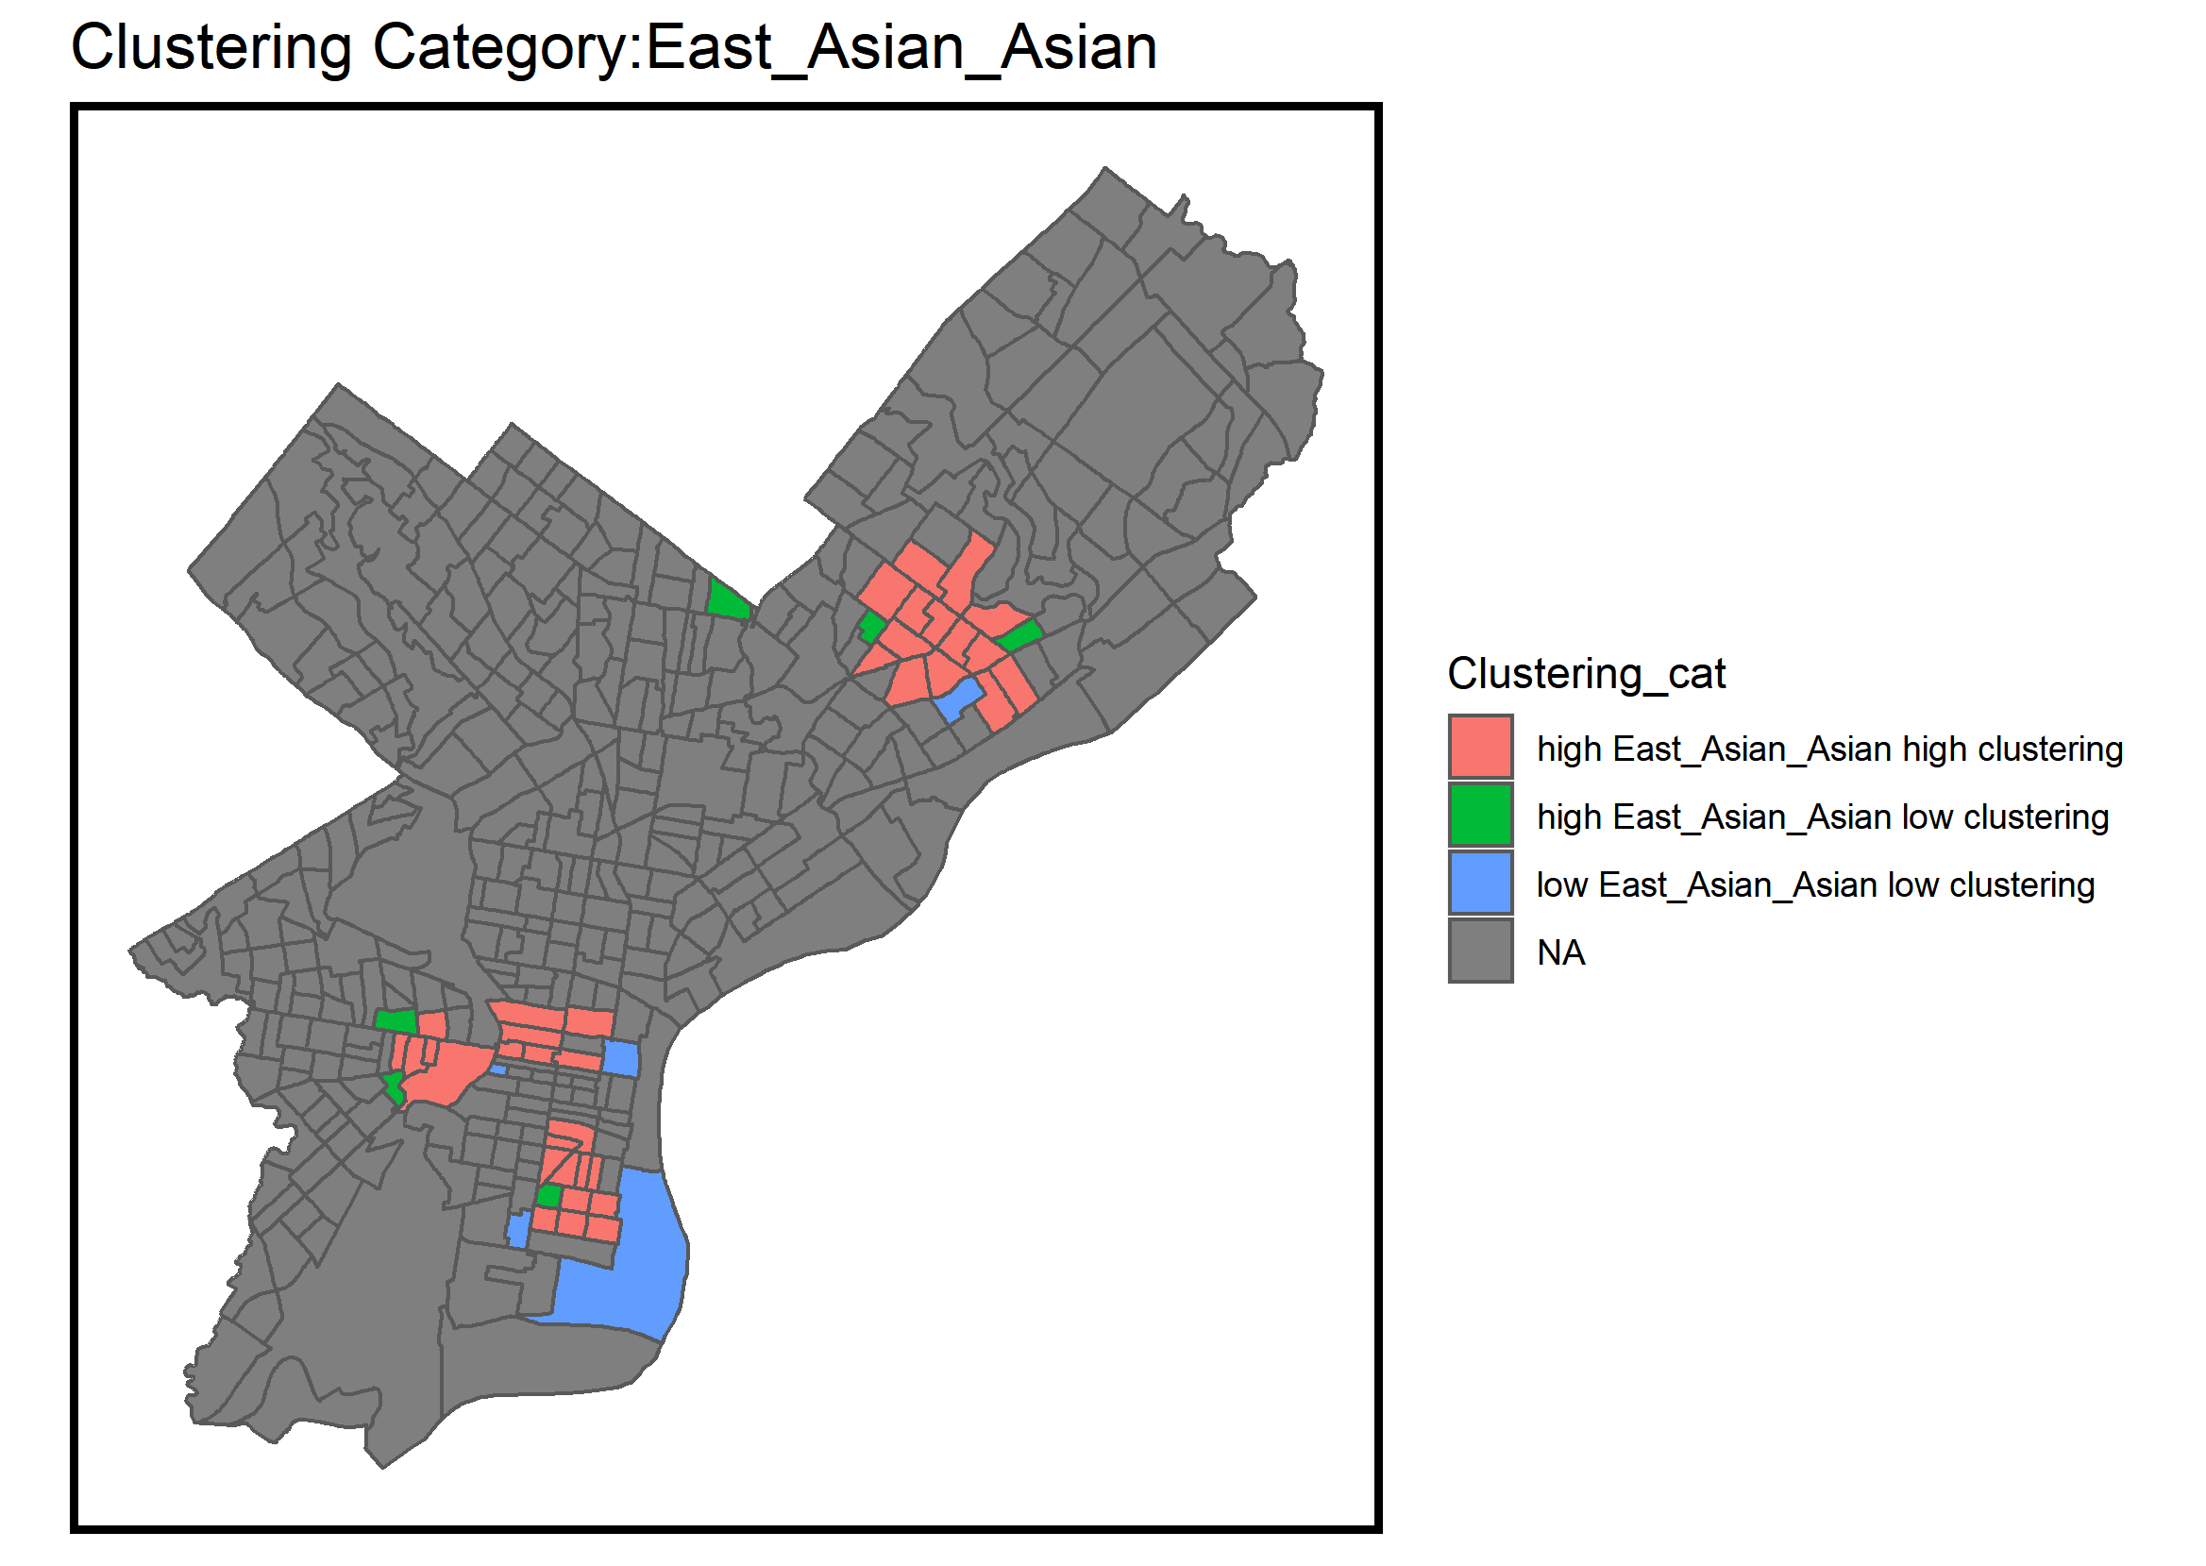
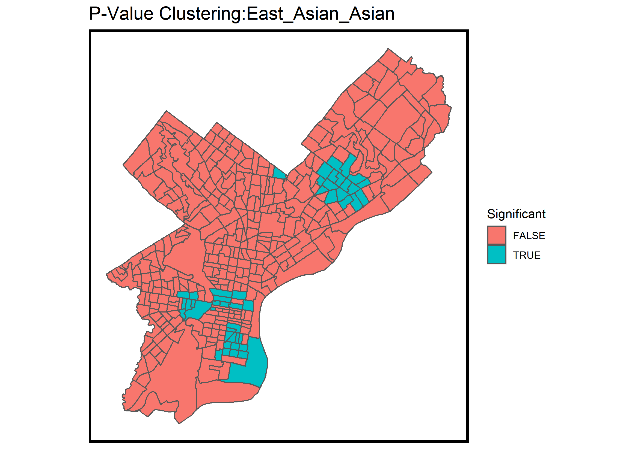
Moran’s I
Are Asian Americans Clustered?

Slide 15
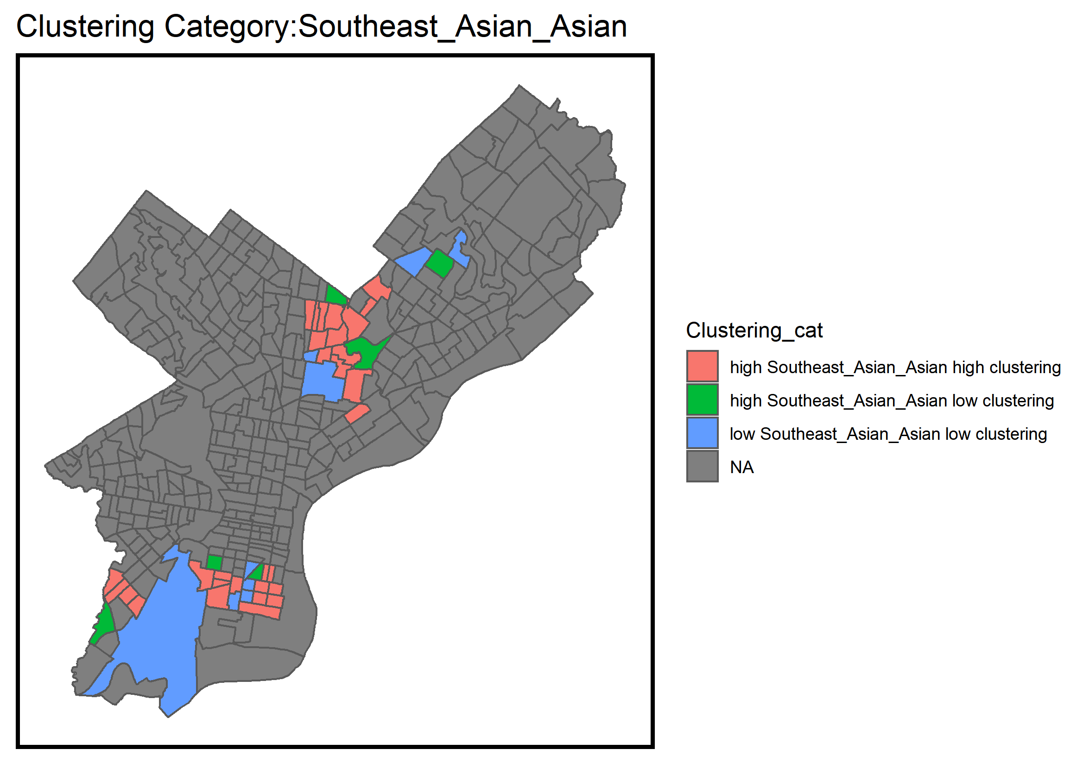
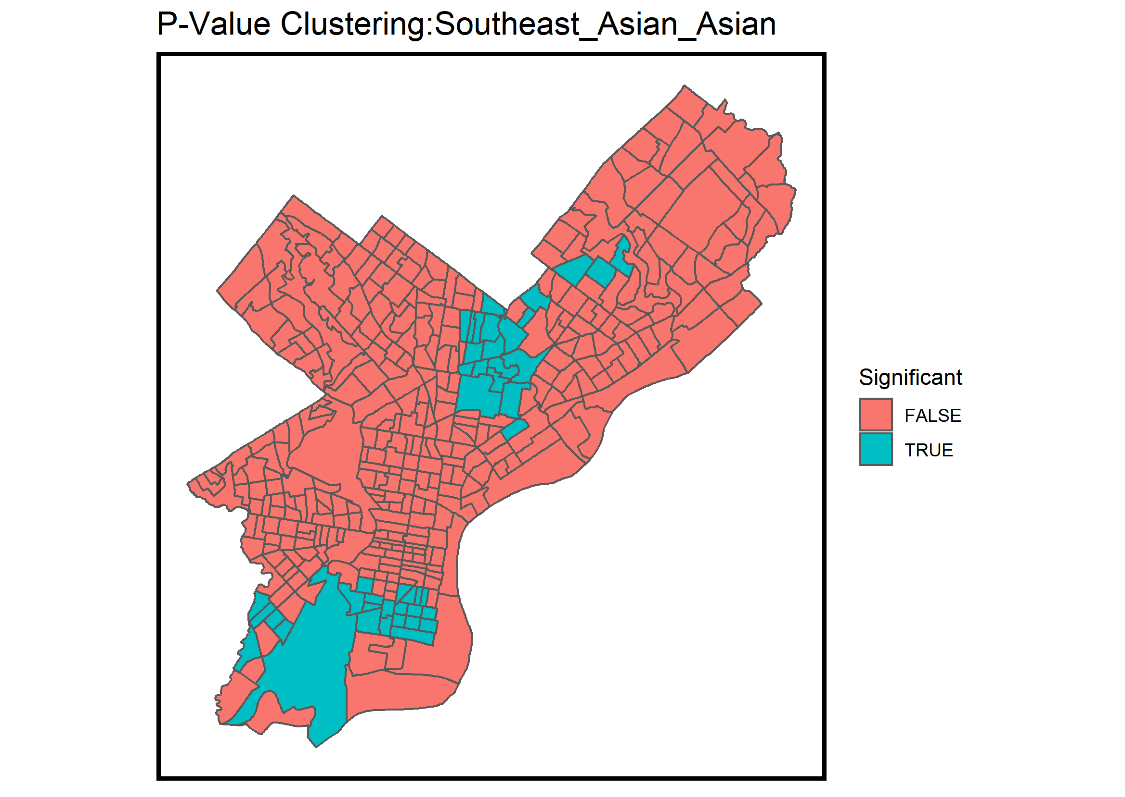
Moran’s I
Are Asian Americans Clustered?

Slide 16
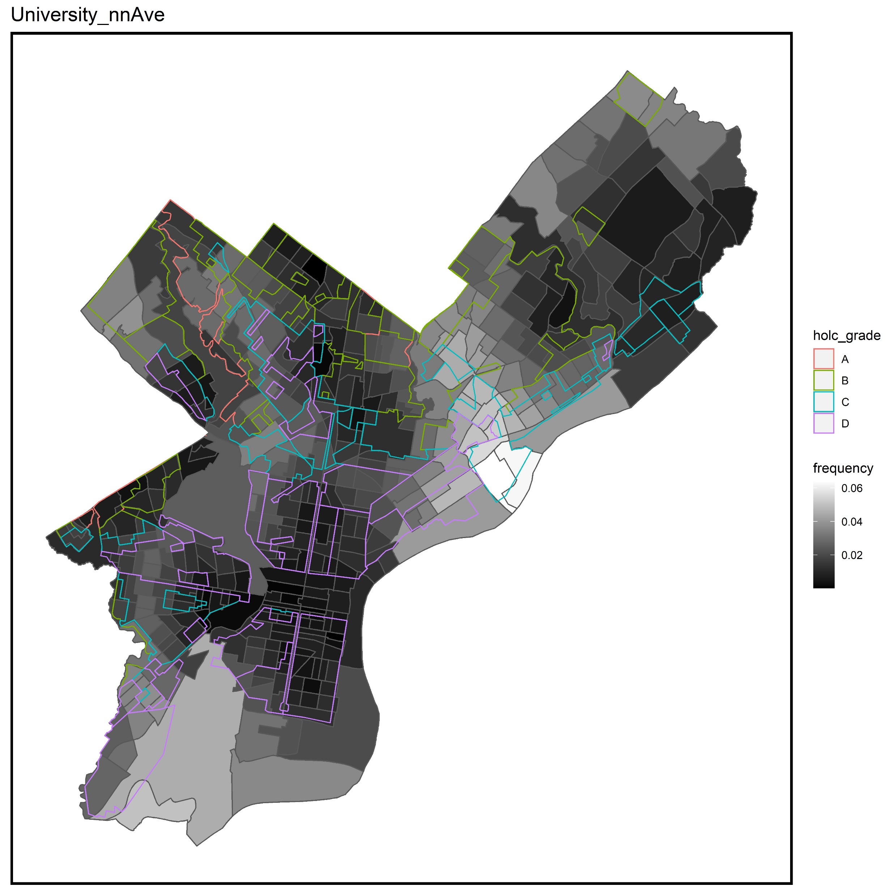
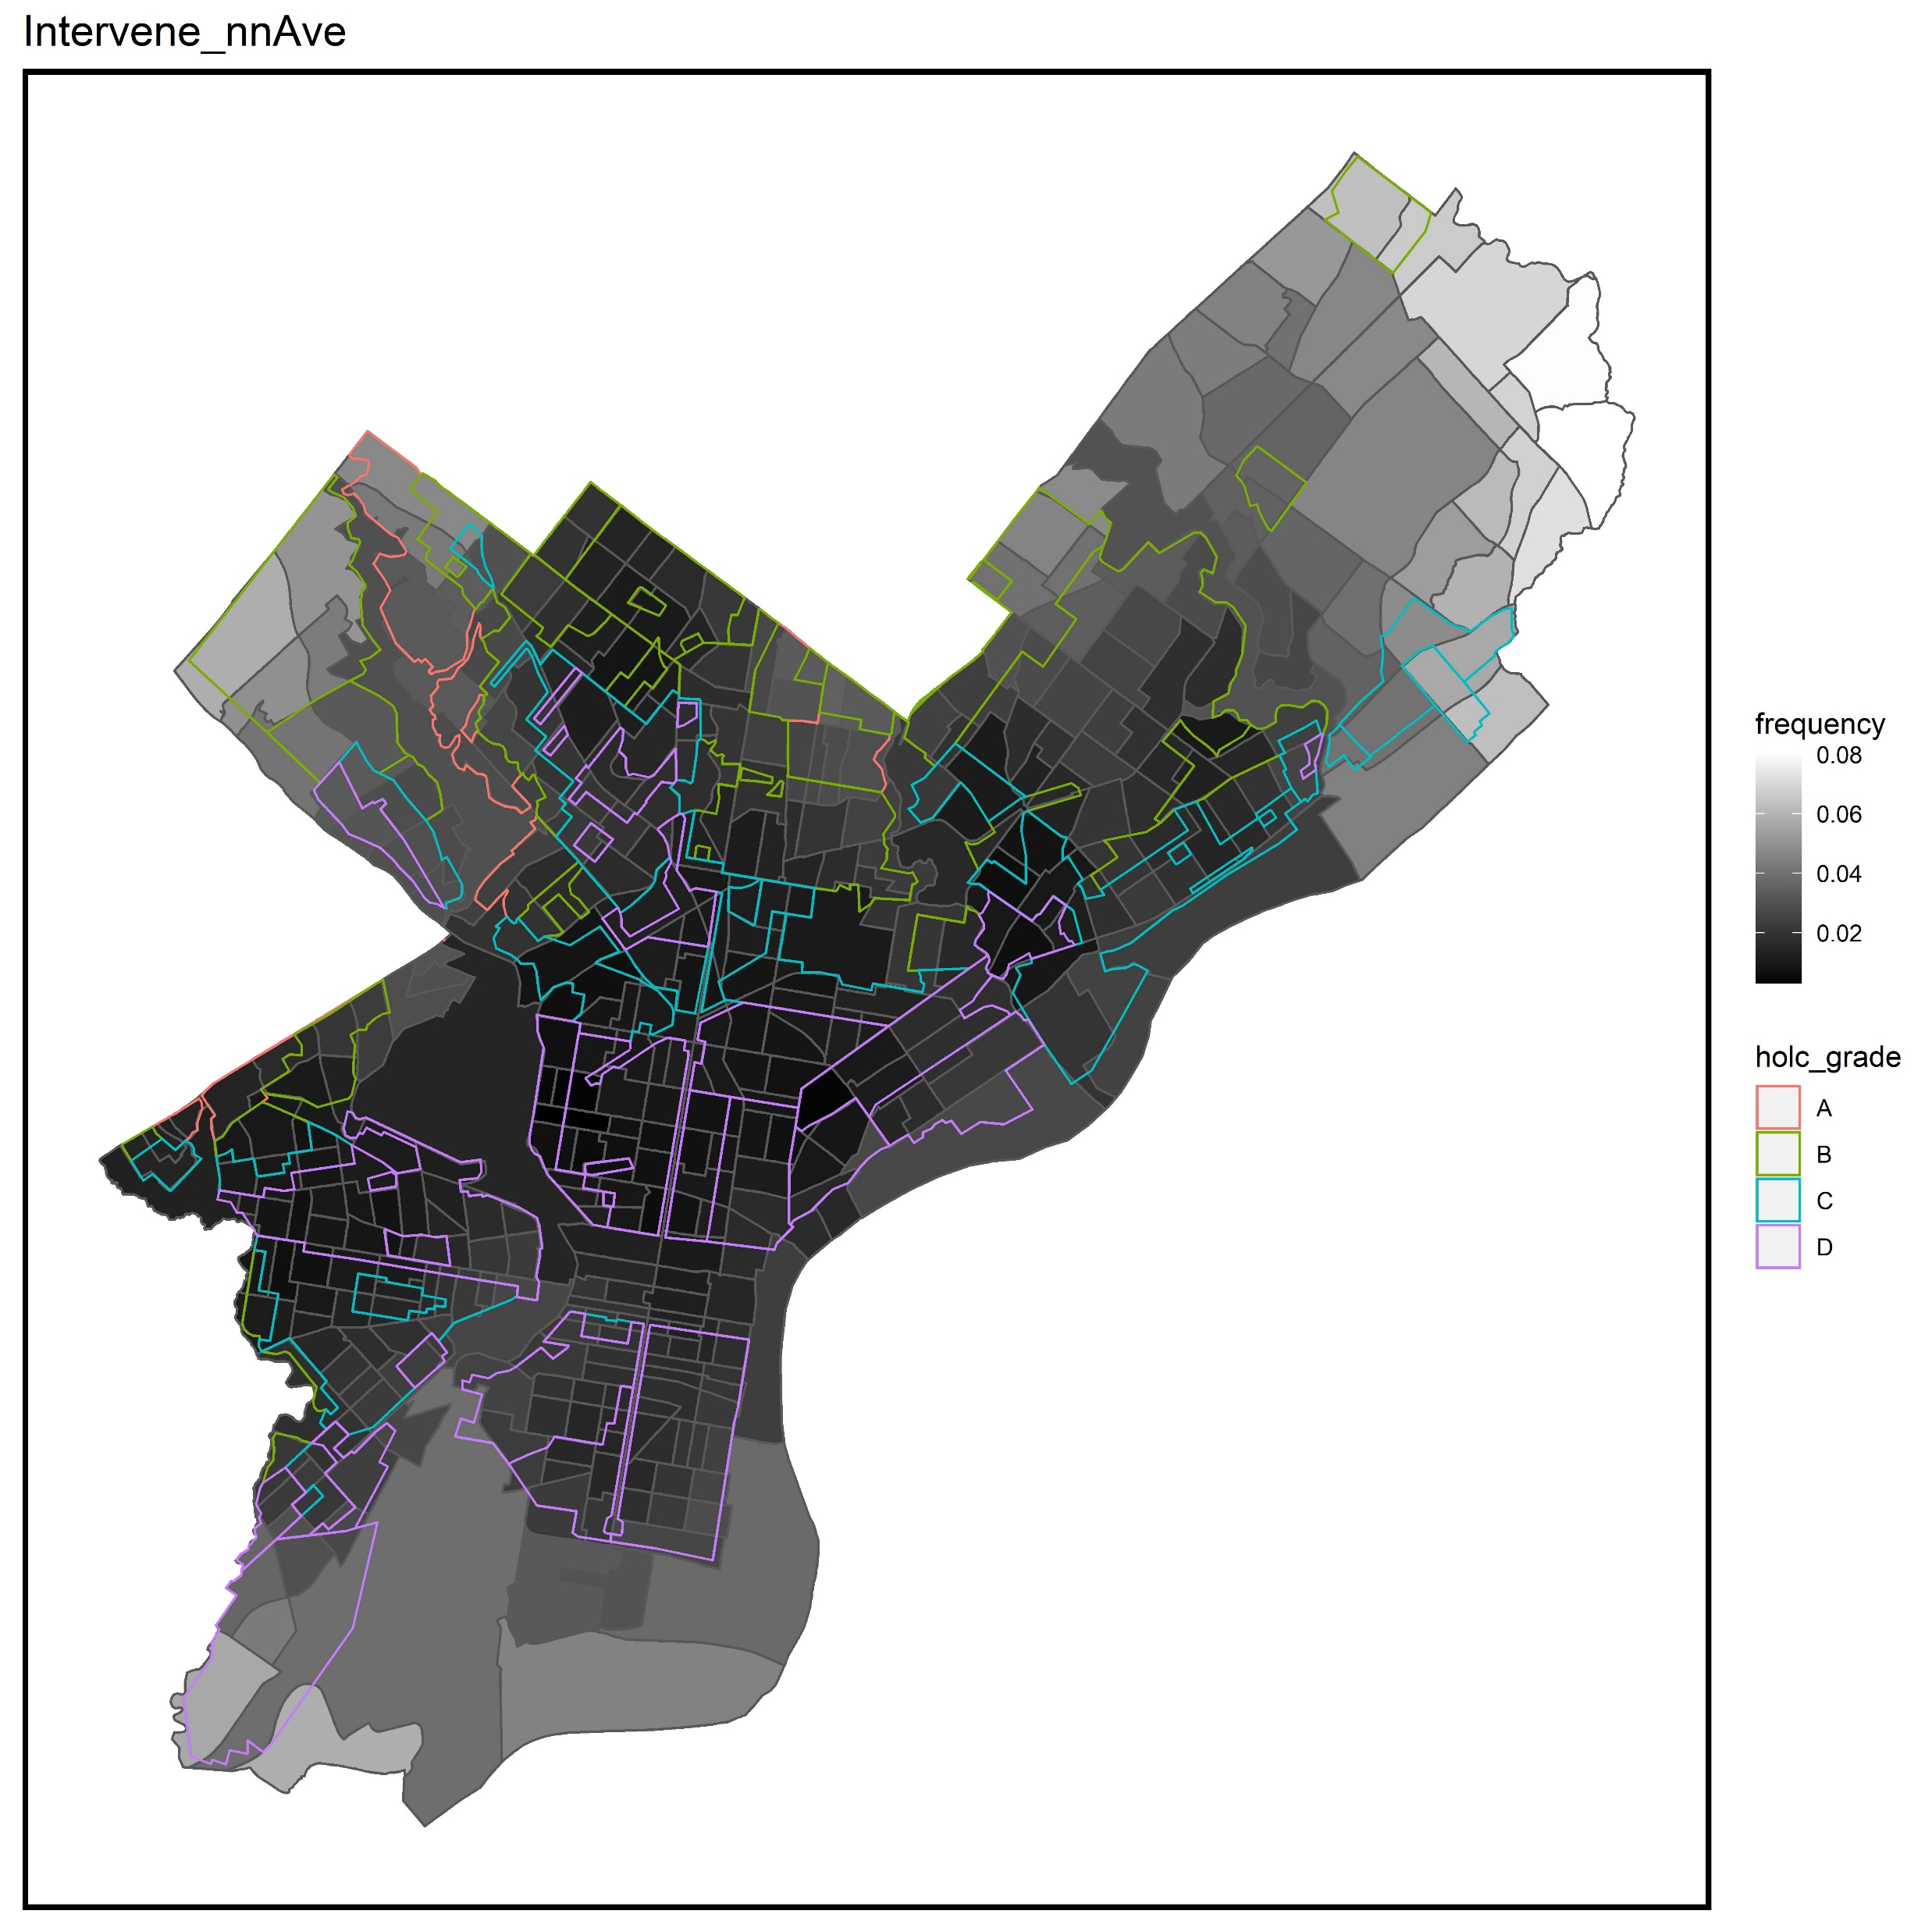
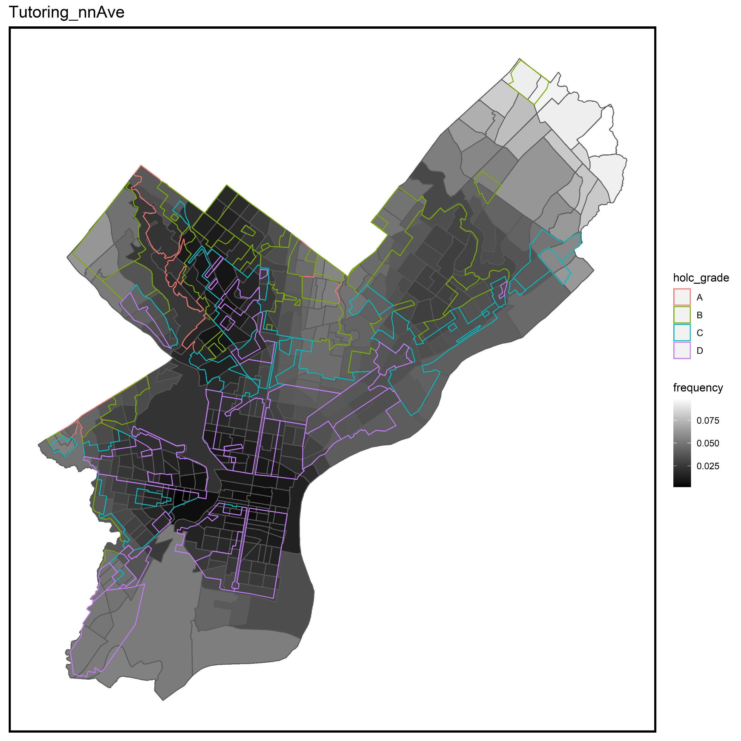
Nearest Neighbor Average

Slide 17
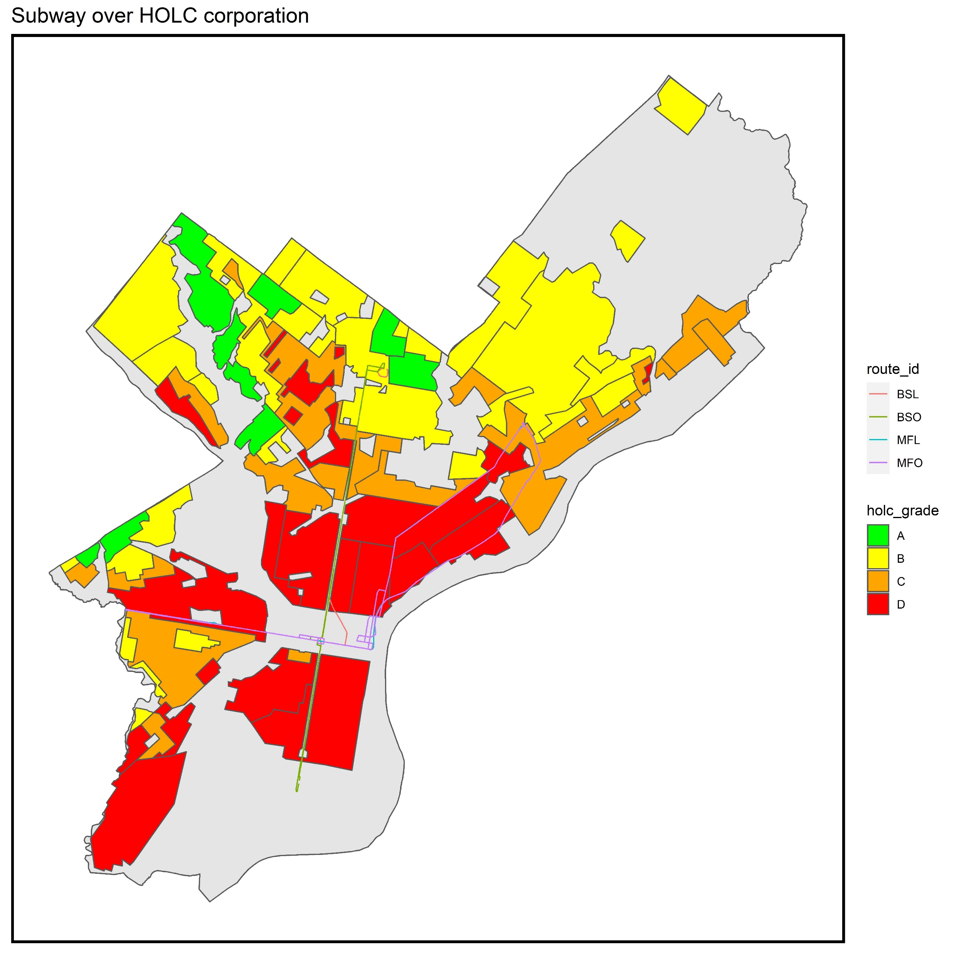
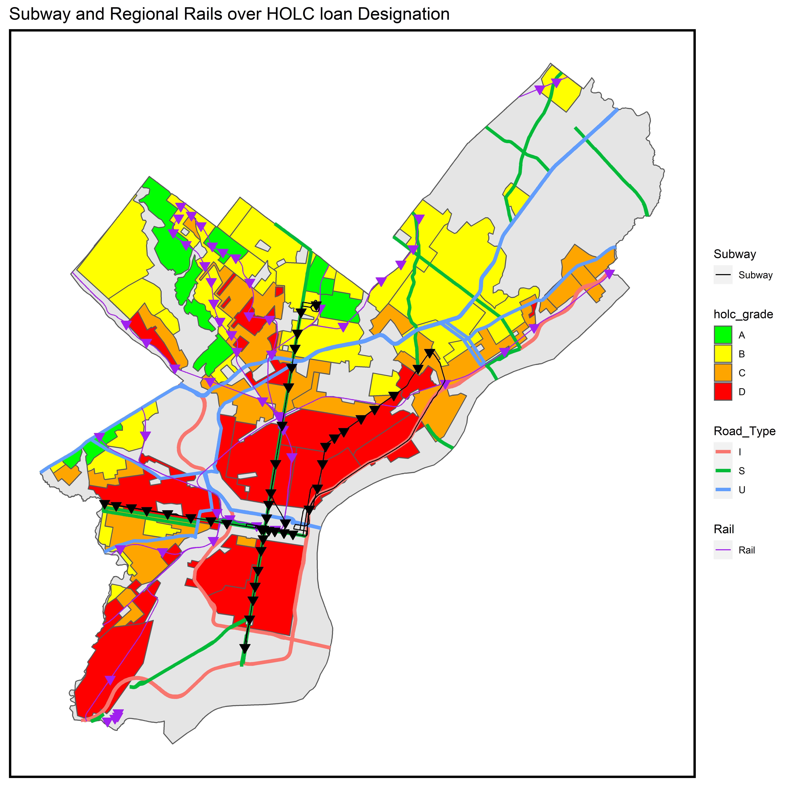
Home Owners Loan Corporation
Are Asian Americans Clustered?

Slide 18

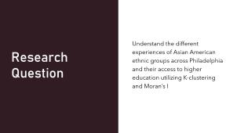


Summary

